Slide 1
MARKETING & RetaiL aNALYTICS
Asesh Sahoo

Slide 2
Problem Statement
A Café chain shared data of one of its restaurants. The key objective here is to conduct thorough data analysis and come up with recommendations that can help the café chain to increase its revenue. Data provided is POS (Point of sale) for one of its chains. Goal is to identify the most popular combos that can be suggested to the Cafe chain after a thorough analysis of the most commonly occurring sets of menu items in the customer orders. The Store doesn’t have any combo meals. Using the market basket analysis, recommend combo plans that café chain can offer to its customers
Steps to be followed :
Exploratory Analysis of data & an executive summary
Trends across Products, Dates, Categories
Importance of the association rules and their relevance in the current use case
Add KNIME workflow Image
The threshold values of Support and Confidence
Associations in a tabular format
Support, confidence & lift values are calculated
Recommendations through analysis

Slide 3
Exploratory Data Analysis

Slide 4
Data Summary
• There are no missing values in the data
• There are 145,830 rows and 10 Columns in the original dataset provided
• There are no duplicate rows in the data
• There are 69982 Unique Transactions and 580 Unique products
• The data is for the year April,2010 – Mar,2011
• There are 9 unique categories in the data
• Additional columns like Month, Weekday of Billed date, Hour, Minute of Billed time are included for further analysis

Slide 5
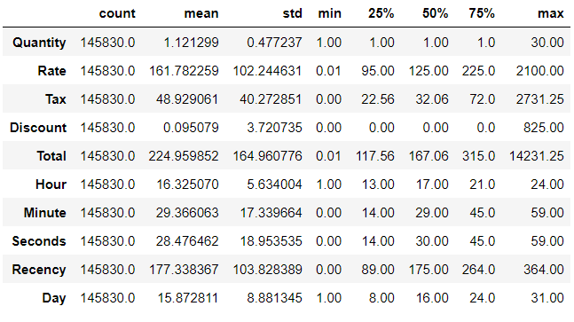
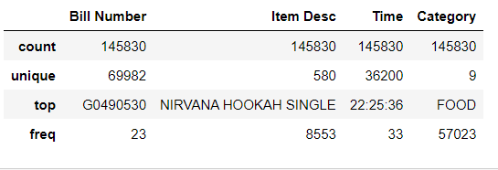
Data ANalysis
Below image shows the data summary at high level

Slide 6
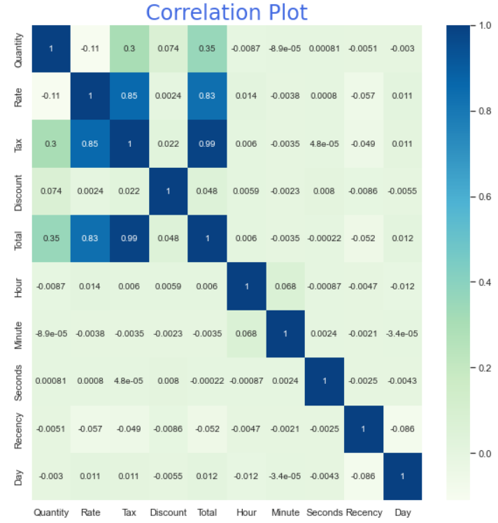
Correlation chart
High correlations are noted between Total, Tax, and Rate.
Some correlation can also be seen between Total, Quantity and Tax but it can be ignored as the value is low.

Slide 7
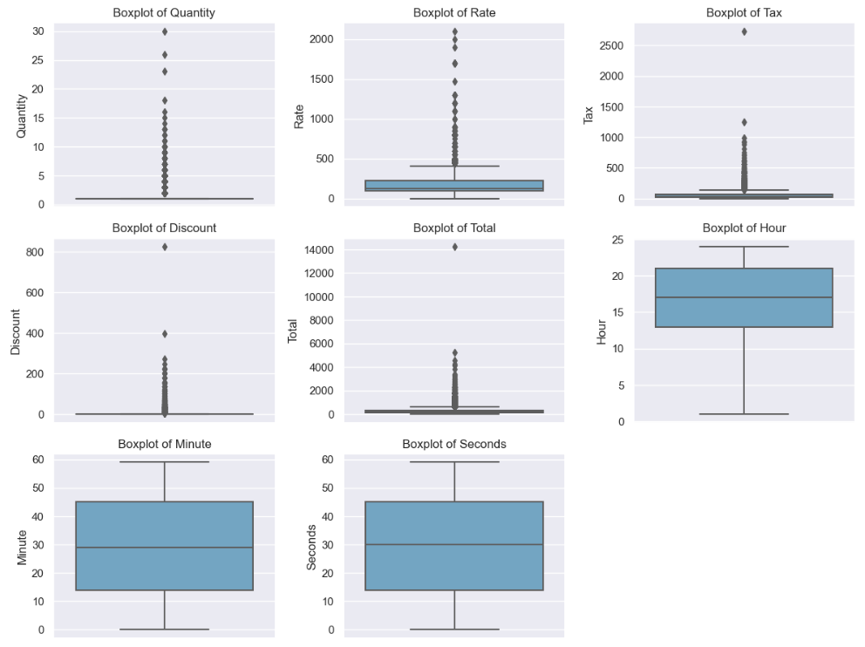
Boxplots
Significant outliers are noted in Quantity, Rate, Tax, Discount, and Total
Hours are skewed indicating more transaction happen in the during 2nd half of the day

Slide 8
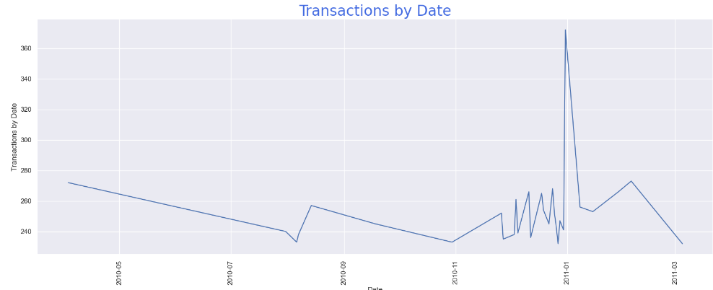
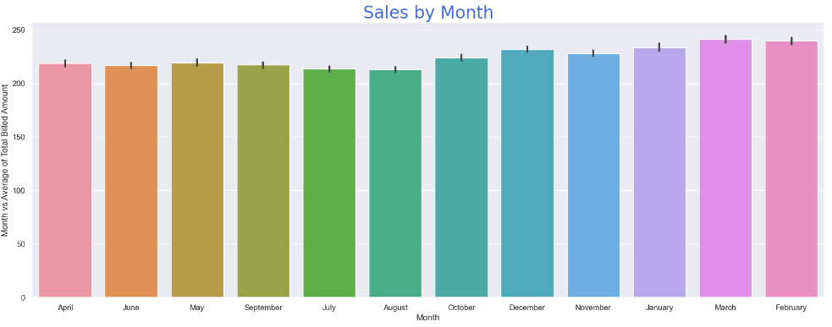
Order Counts Trends
There are good number of transactions seen in the month of December and January. It could be due to Christmas and new year. Not enough data to check seasonality.

Slide 9
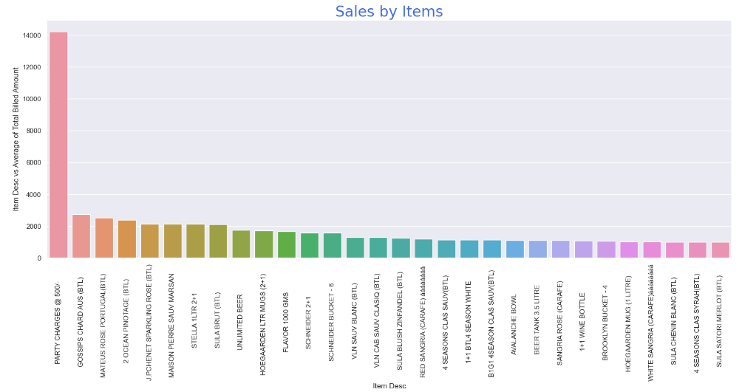
Sales by ITEM
Top product sold is “Party Charges”. Average sales is approx.14000 .Subsequent products are sold at an average of approx. 2000.

Slide 10
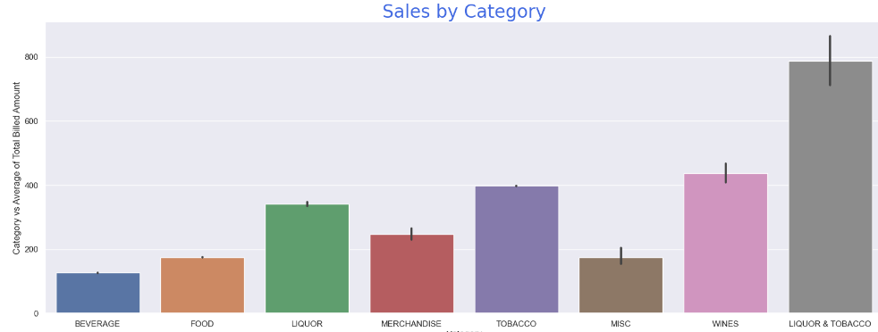
Sales by Category
Top product sold is “Liquor and Tobacco”. Average sales is approx. 800. Subsequent products are sold at an average of aprpox 400.

Slide 11
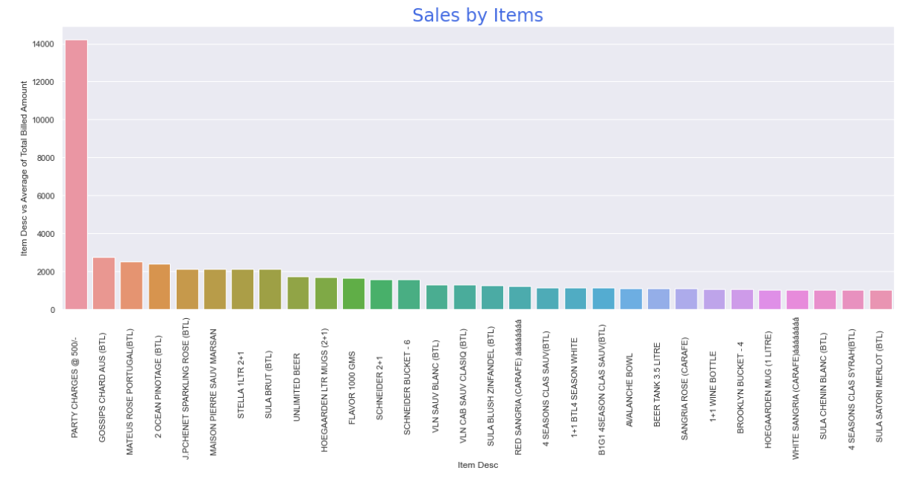
Item wise Total
Top Item sold is “PARTY CHARGES @ 500/-”

Slide 12
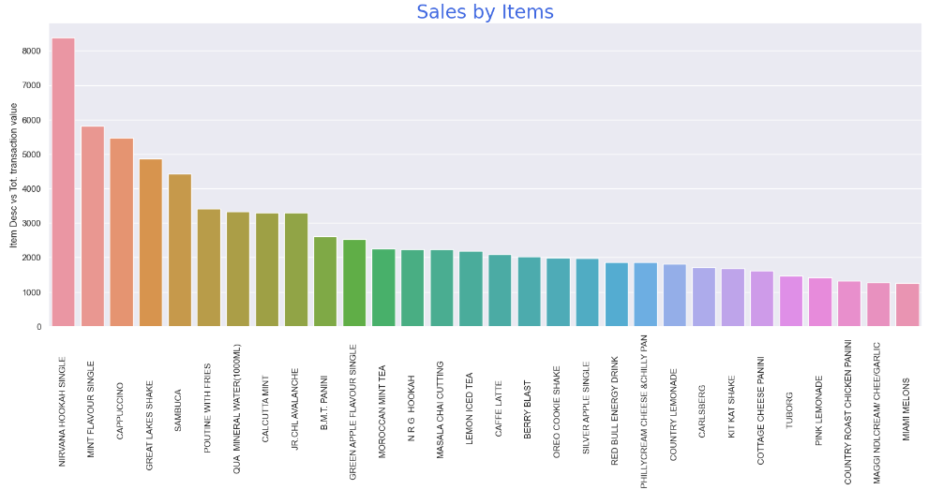
ITEM wise Transaction value
Top Item sold based on total transaction value is “NIRVANA HOOKAH SINGLE”

Slide 13
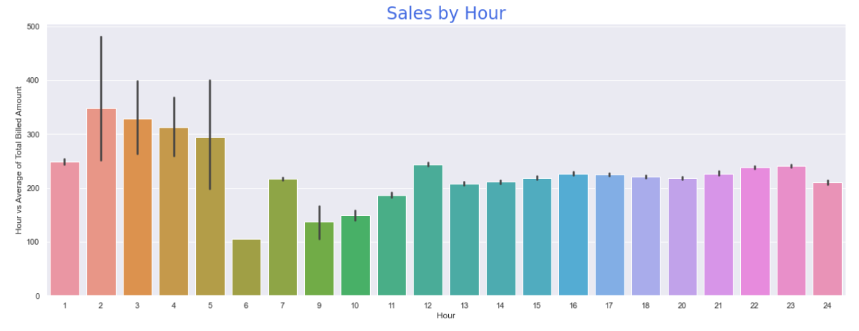
Hour Wise sale transaction
Most sales transaction during 1st half of the day. Average sales cross aprox. 300 in the initial 5 hours. Average sales is close to 200 for rest of the day

Slide 14
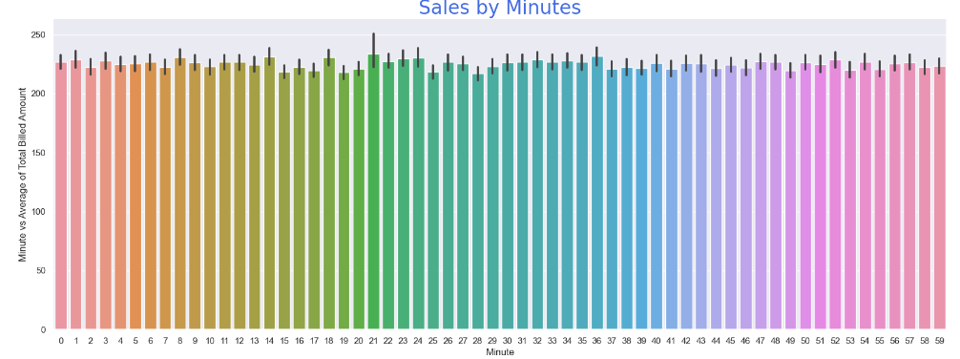
Minute Wise Sale Transactions
No correlation is found between sales and minute of Sales transaction

Slide 15
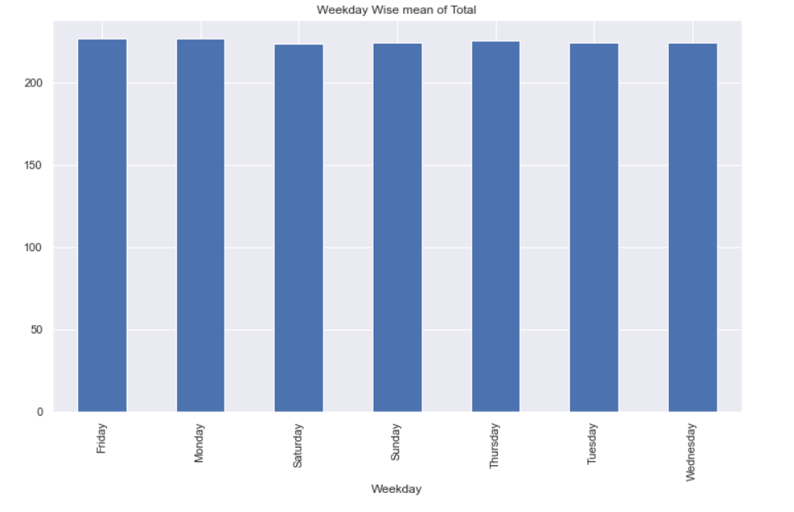
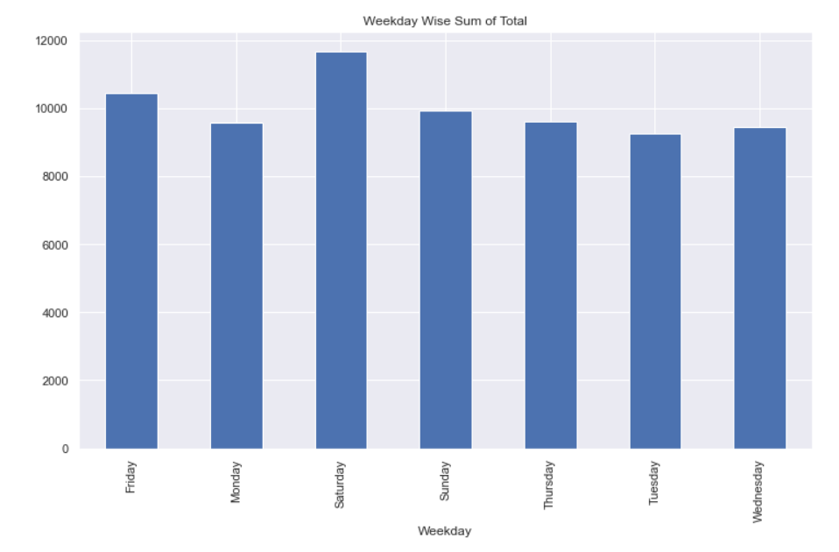
Transactions by Day of week
Weekend i.e. “Saturday” and “Sunday” witnesses more transactions compared to other days in the week
Average total is similar across all days of the week

Slide 16
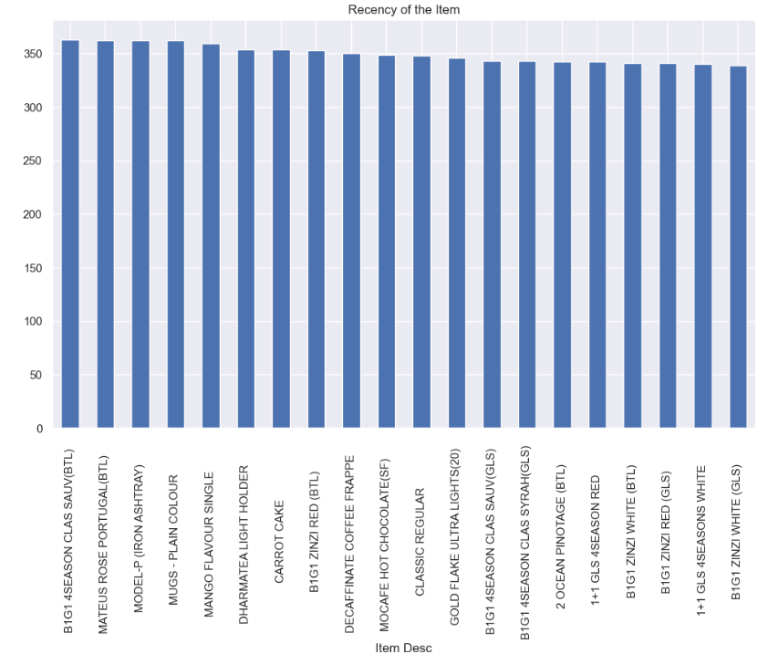
Items suggested to be dropped from the Menu
Items shown in the image were purchased an year ago and have no latest transactions. Recency is calculated from base date i.e. 01 Apr 2010 .
Items shown in the image are suggested to be dropped from the food menu.

Slide 17
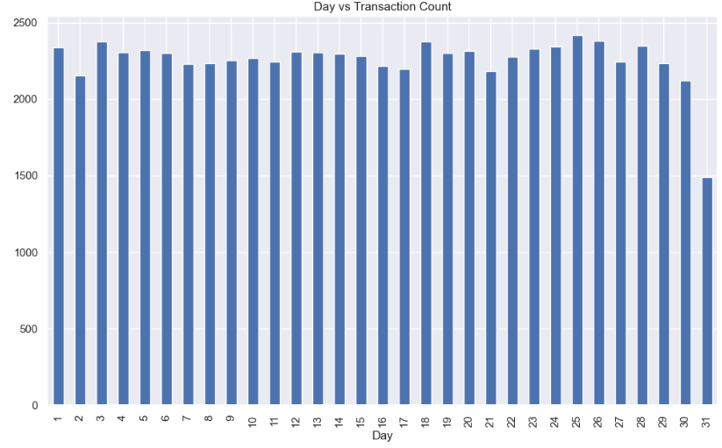
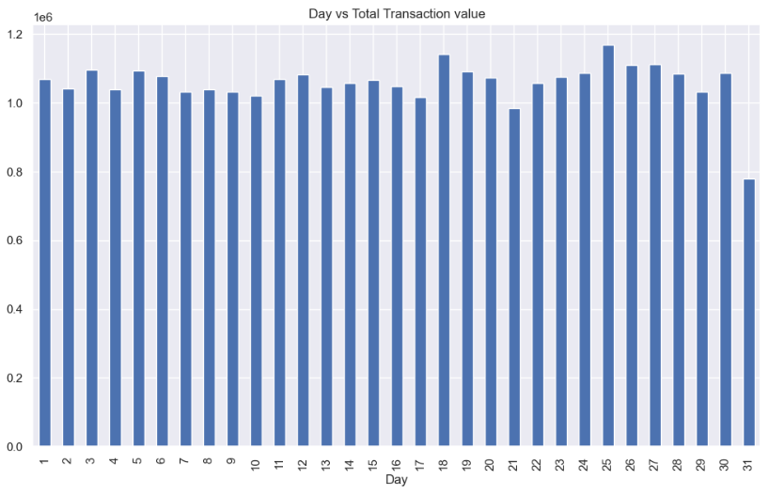
Transactions by day of month
No trend is identified on the Day of month w.r.t Average of Total transaction value or Transaction count

Slide 18
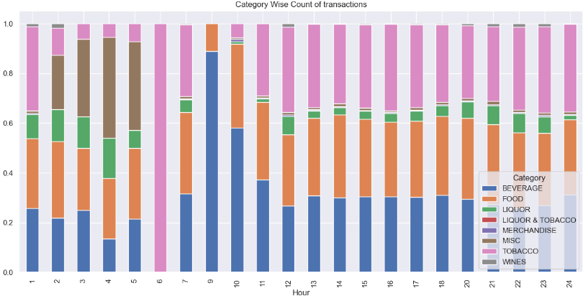
Transactions by category during the day (hour)
Good number of transactions are recorded for Category “Misc” initial hours of the day
Transactions for only 1 category i.e. “Tobacco” is seen during 6th hour of the day
Very high transactions for “Merchandise” is seen during 9th hour of the day.

Slide 19
Key Observations
Liquor& Tobacco is the most frequently ordered item followed by Wines and Tobacco
Data set is for 9 months of 2010, 3 months of 2011
1st half of the day records the highest amount of Total transaction value.
Initial few hours of the day have relatively high transactions related to Category “Misc” than other parts of the day
There is no significant trend between the minutes of transactions compared to Total transaction value/Transaction count
Saturday and Sunday have high transactions compared to other weekdays.
Products like “B1G1 4SEASON CLAS SAUV(BTL)”, and “MATEUS ROSE PORTUGAL(BTL) “seem to be obsolete items, that can be removed from the menu.
Transactions for only 1 category i.e. “Tobacco” is seen during 6th hour of the day
Very high transactions for “Merchandise” is seen during 9th hour of the day.

Slide 20
Market Basket Analysis

Slide 21
Why Market Basket Analysis ?
Problem statement involves the business of a café chain restaurant where there is a lot of transactions across multiple items and Categories. Café chain owner wants to understand customer purchase pattern so that combo offers can be designed and presented to customer.
The output of it can be used as changes to offerings to customer which will result in increased customer experience, customer retention, sales, etc. that’ll help the business continue to grow revenue, profit
Association rules will help to identify the items that are most likely to be purchased by the customer when they purchase a specific item
key metrics using which purchase of potential items is evaluated are Support, Lift, and confidence.

Slide 22
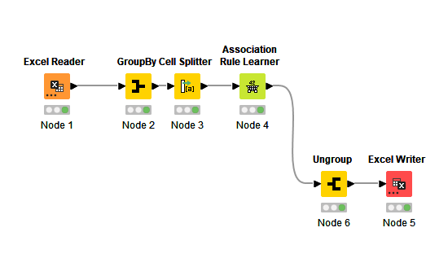
KNIME workflow
Threshold value for Support is 0.001 and Confidence is 0.001
633 association rules are formed using above mentioned support and confidence values.

Slide 23
Output of Association Rules Learner
RowID | Support | Confidence | Lift | Consequent | implies | Items
rule58_1 | 0.001043125 | 0.17804878 | 79.36439335 | ADD HERB ROAST CHICKEN | <--- | LEMON INFUSED CHAR GRILLED VEG
rule59_1 | 0.001043125 | 0.464968153 | 79.36439335 | LEMON INFUSED CHAR GRILLED VEG | <--- | ADD HERB ROAST CHICKEN
rule366_1 | 0.001614701 | 0.54589372 | 18.23519537 | CAFFE LATTE | <--- | ADD HAZELNUT FLAVOUR
rule367_1 | 0.001614701 | 0.053937947 | 18.23519537 | ADD HAZELNUT FLAVOUR | <--- | CAFFE LATTE
rule116_1 | 0.001128862 | 0.105053191 | 7.478975022 | SATAY CHICKEN PANINI | <--- | ADD FRIES
rule117_1 | 0.001128862 | 0.080366226 | 7.478975022 | ADD FRIES | <--- | SATAY CHICKEN PANINI
rule27_1 | 0.001014547 | 0.027255278 | 7.143741149 | FRENCH FRIES | <--- | B.M.T. PANINI
rule26_1 | 0.001014547 | 0.265917603 | 7.143741149 | B.M.T. PANINI | <--- | FRENCH FRIES
rule195_1 | 0.001243177 | 0.06580938 | 6.124297888 | ADD FRIES | <--- | COUNTRY ROAST CHICKEN PANINI
rule194_1 | 0.001243177 | 0.115691489 | 6.124297888 | COUNTRY ROAST CHICKEN PANINI | <--- | ADD FRIES
rule258_1 | 0.001371781 | 0.463768116 | 5.935519439 | CAPPUCCINO | <--- | ADD HAZELNUT FLAVOUR
rule259_1 | 0.001371781 | 0.017556693 | 5.935519439 | ADD HAZELNUT FLAVOUR | <--- | CAPPUCCINO
rule196_1 | 0.001243177 | 0.412322275 | 5.923863158 | GREAT LAKES SHAKE | <--- | VANILLA ICECREAM
rule197_1 | 0.001243177 | 0.017860809 | 5.923863158 | VANILLA ICECREAM | <--- | GREAT LAKES SHAKE

Slide 24
Inference (Highest Lift)
Rule58_1
Support indicates that 0.10% of total transactions were of “Lemon Infused Char Grilled Veg”
Confidence indicates that 17.8% of the total transactions where “Lemon Infused Char Grilled Veg” was purchased also had a purchase of “Add Herb Roast Chicken”
lift is there is a 7936% increase in expectations that customers will buy “Add Herb Roast
Chicken” when they purchase “Lemon Infused Char Grilled Veg”
Rule366_1
Support indicates that 0.16% of the transactions were for “Add Hazelnut Flavor”
Confidence says that 54.5% of the customers who purchased “Add Hazelnut Flavor” also purchased “Caffe Latte”
lift is that there is a 1823% increase in expectations that customers will buy “Caffe Latte” when they purchase “Add Hazelnut Flavor”

Slide 25
Interpretation – Most Purchased Item (Nirvana Hookah Single )
rule579_1
Support indicates that 0.3% of the transactions were for “Nirvana Hookah Single”
Confidence says that 2.5% of the total transaction where“Nirvana Hookah Single” was purchased also had a purchase of “Red Bull 2+1”
lift is that there is a 54% increase in expectations that customers will buy “Red Bull 2+1” when we know that they purchase “Nirvana Hookah Single”

Slide 26
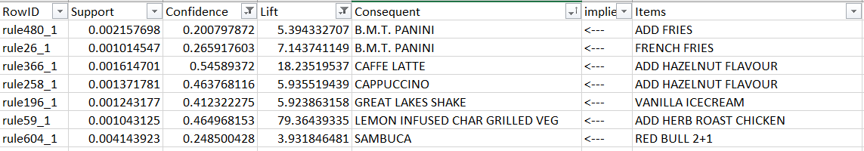
Selecting Top Rules ( Confidence > 0.2 and Lift > 2)
1
2
rule480_1
Support indicates that 0.2% of total transactions were for “Add Fries”
Confidence indicates that 20% of the transactions that involved a purchase of “Add Fries” also had a purchase of “B.M.T. PANINI”
lift is that there is a 439% increase in expectations that customers will buy “B.M.T. PANINI” when they purchase “Add Fries”

Slide 27
Recommendation
Using the rules, we can suggest the business that they can introduce a combo with B.M.T. PANINI, French Fries
and Add Fries
With the data, we can see that 754 Bill Numbers have “Add Fries”, 2,606 Bill Numbers have “B.M.T. PANINI”, 268 Bill
Numbers have “French Fries”.
Using this data, we can suggest a combo of Add Fries, B.M.T PANINI, French Fries as a
Platter with suitable price.

Slide 28
Thank You

